Slide 1
Design Patterns
(Part 3)
CSCE 247 - Lecture 20 - 04/03/2019
Notes:
Add an activity? Think about this.

Slide 2
Design Patterns
Strategy Pattern encapsulates interchangeable behaviors and uses delegation to decide which one to use.
Observer Pattern allows objects to be notified when state changes.
Visitor Pattern provides a way to traverse a collection of objects without exposing its implementation.
Factory Pattern encapsulates object creation so that the system doesn’t need to know what type of object was created.
Notes:
Design Patterns take these principles and show us how to realize them within our software. They take common situations in software design and offer tips on how to build your system such that those principles hold. We’ve covered
(read)

Slide 3
Design Patterns
Decorator Pattern wraps an object to provide new behavior.
Adapter Pattern wraps an object and provides a different interface to it.
Facade Pattern simplifies the interface of a set of classes.
Command Pattern encapsulates a request as an object.
Notes:
(read)
There are dozens more out there. I recommend looking over them, figuring out which apply to your project, and keeping them in mind for any of your future work.

Slide 4
Today
Template Method Pattern encapsulates pieces of algorithms so that subclasses can hook into a computation.
Iterator Pattern encapsulates the details of iterating through collections of items.
Composite Pattern allows transparent treatment of collections and items.
How we can bring patterns together in a complex system.

Slide 5
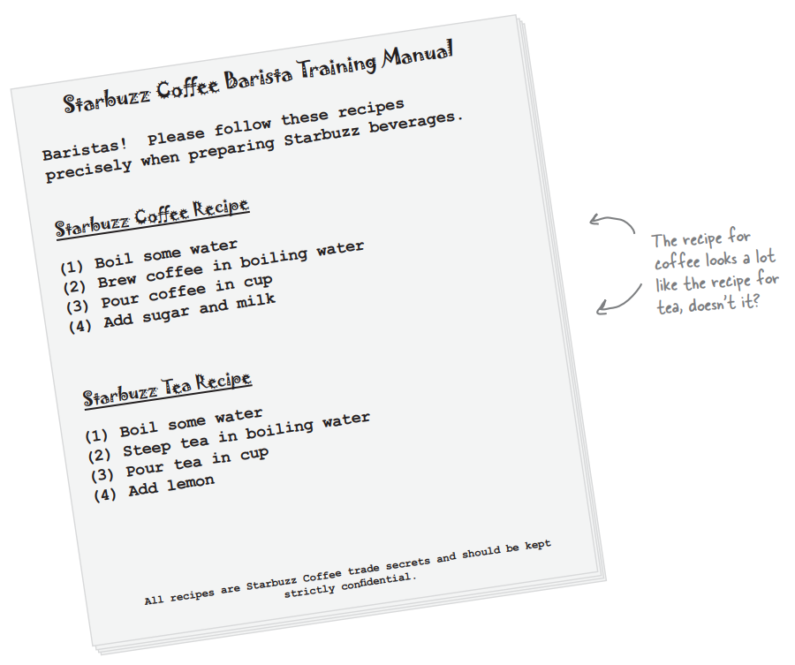
Coffee and Tea
Notes:
Last time, we talk an awful lot about this coffee shop. Some of us can’t live without our coffee. Well, some of us are tea maniacs instead. And, as it turns out, coffee and tea are made in a very similar way. (go over recipe)

Slide 6
Coffee and Tea (In Code)
Coffee
prepareRecipe()
boilWater()
brewCoffeeGrinds()
pourInCup()
addSugarAndMilk()
Tea
prepareRecipe()
boilWater()
steepTeaBag()
pourInCup()
addLemon()
void prepareRecipe(){
boilWater();
brewCoffeeGrinds();
pourInCup();
addSugarAndMilk()
}
void prepareRecipe(){
boilWater();
steepTeaBag();
pourInCup();
addLemon()
}
Notes:
So, let’s see how these might look in a system built to brew both. Coffee - go over. prepareRecipe just steps through each stage of the preparation process - each in its own method. Now, let’s look at tea. The second and fourth steps are different, but these are very similar processes. It’s basically the same recipe. We have some code duplication going on here. When we have duplication, that’s a good sign we need to clean up the design. First inclination - right - we should take common steps and abstract them into a base class and inherit those common steps.

Slide 7
Coffee and Tea (In Code) - Take 2
CaffeineBeverage
prepareRecipe()
boilWater()
pourInCup()
Coffee
prepareRecipe()
brewCoffeeGrinds()
addSugarAndMilk()
Tea
prepareRecipe()
steepTeaBag()
addLemon()
Notes:
Your first redesign might look like this. BoilWate and PourInCup are common, so they are implemnted in the parent and we declare an abstract method prepareRecipe that each child must implement - in addition to new behaviors unique to those children. Did we do a good job on the redesign? Are we overlooking some other commonality? Are there other ways that coffee and tea are similar, that we can take advantage of?

Slide 8
Back to the Recipes
Algorithm
Boil some water.
Use hot water to extract the beverage from a solid form.
Pour the beverage into a cup.
Add appropriate condiments to the beverage.
Steps 1 and 3 are already abstracted into the base class.
Steps 2 and 4 are not abstracted, but are basically the same concept applied to different beverages.
Notes:
What else do coffee and tea have in common? Let’s look at the recipes. Both recipes follow essentially the same algorithm. (algo and bullets)
So, can we find a way to abstract prepareRecipe() too?

Slide 9
Abstracting prepareRecipe()
Coffee uses brewCoffeeGrinds() and addSugarAndMilk(), Tea uses steepTeaBag() and addLemon().
But steeping and brewing aren’t all that different.
Rename both to brew().
Adding sugar is just like adding lemon.
Rename both to addCondiments().
void prepareRecipe() { boilWater(); brew(); pourInCup(); addCondiments(); }
Notes:
(go over). So, now we have a new prepareRecipe method.

Slide 10
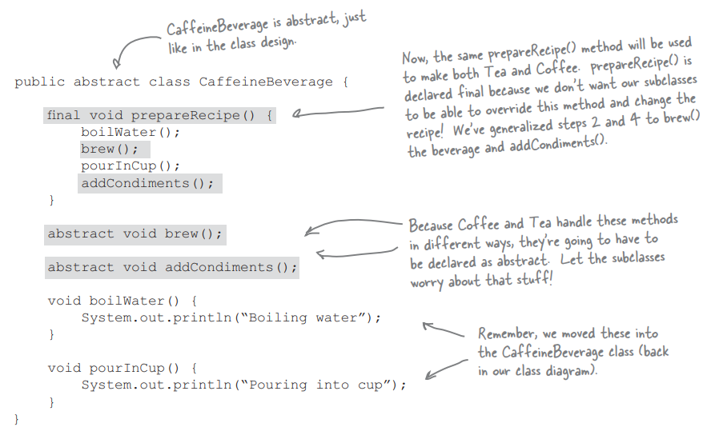
Our Redesigned Code
CaffeineBeverage
prepareRecipe()
brew()
addCondiments()
boilWater()
pourInCup()
Tea
brew()
addCondiments()
Coffee
brew()
addCondiments()
Notes:
(go over caffeinebeverage - base class, abstract brew/add, prepareRecipe protected from being overridden)
Then, we need to deal with Coffee and Tea classes. They now rely on CaffeineBeverage to handle the recipe, so they just need to handle brewing and condiments

Slide 11
What Have We Done?
We’ve recognized that two recipes are essentially the same, although some of the steps require different implementations.
We have generalized the recipe and placed it in a base class.
CaffeineBeverage knows and controls the steps of the recipe. It performs common steps itself.
(encapsulating what does not change...)
It relies on subclasses to implement unique steps.
(... from what does change)

Slide 12
The Template Method Pattern
prepareRecipe() is our template method.
It is a method.
It serves as a template for an algorithm.
In the template, each step of the algorithm is represented by a method.
Some methods are handled by the base class, others are handled by the subclasses.
The methods that need to be supplied by a subclass are declared abstract.
Notes:
We’ve just implemented the TemplateMethod Pattern. - a behavioral pattern- (1-3) In this case, an algorithm for making caffenated beverages. (rest) The Template Method defines the steps of an algorithm and allows subclasses to provide the implementation for one or more steps.

Slide 13
What Does the Template Method Get Us?
Original Implementation
Coffee and Tea control the algorithm.
Code is duplicated across Coffee and Tea.
Changes to the algorithm require making changes to the subclasses.
Classes are organized in a structure that requires more work to add a new beverage.
Knowledge of the algorithm and how to implement it is distributed over multiple clases.
Template Method:
CaffeineBeverage class controls and protects the algorithm.
CaffeineBeverage class implements common code.
The algorithm lives in one place and code changes only need to be made there.
The Template Method allows new beverages to be added. They only need to implement specialized methods.
The CaffeineBeverage class contains all knowlege about the algorithm and relies on subclasses to provide implementations.

Slide 14
The Template Method Pattern
The Template Method Pattern defines the skeleton of an algorithm in a method, deferring some steps to subclasses.
Template Method lets subclasses redefine certain steps of an algorithm without changing the algorithm’s structure.
A template is a method that defines an algorithm as a set of steps.
Abstract steps are implemented by subclasses.
Ensures the algorithm’s structure stays unchanged.
Notes:
(go over) - again, providing encapsulation for what does not change and letting you append what does change - in subclasses that provide part of the implementation.

Slide 15
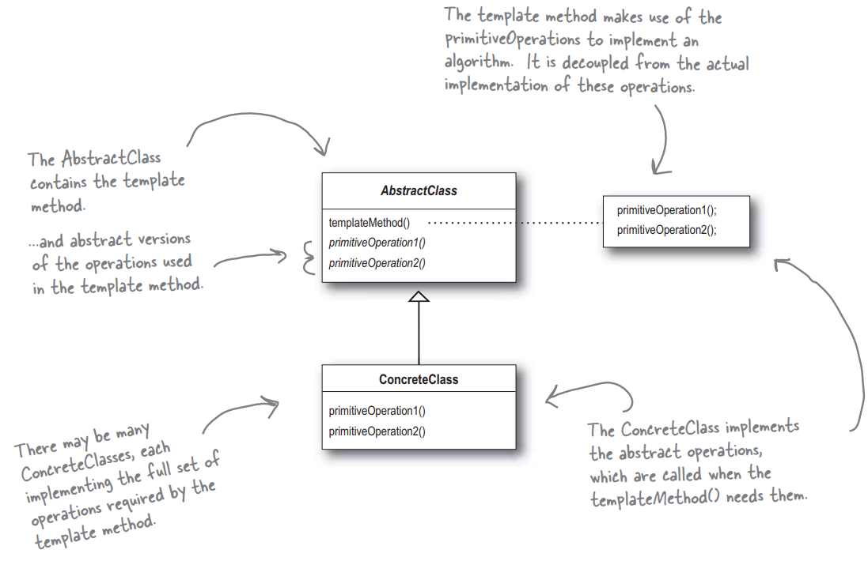
Template Method Pattern

Slide 16
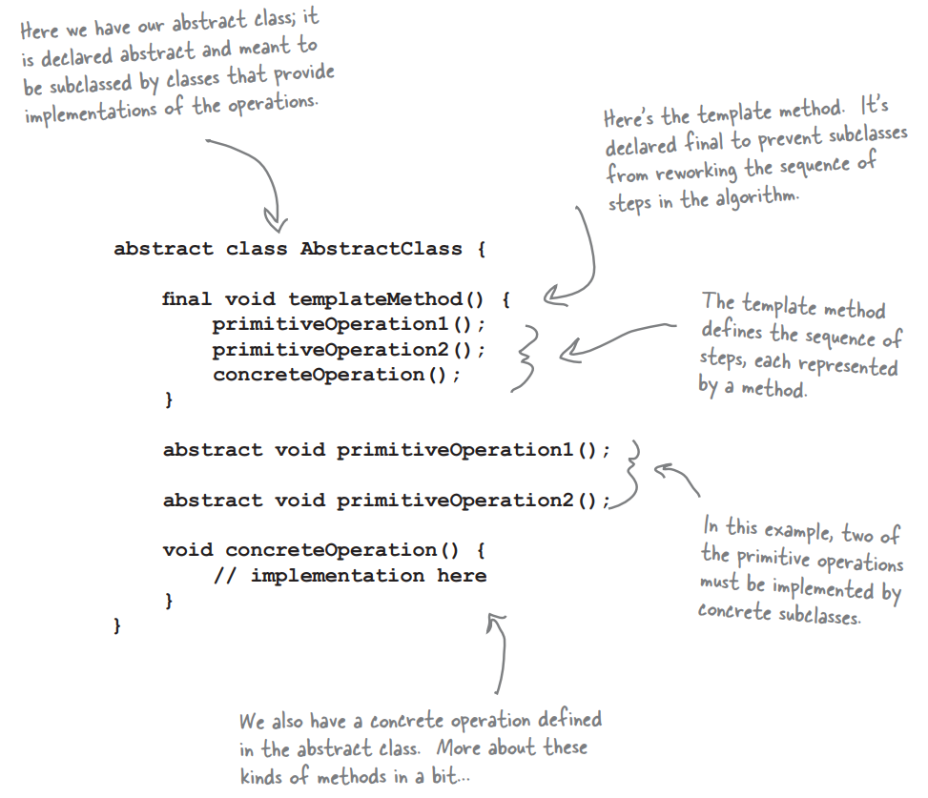
Looking Inside the Code

Slide 17
Adding Hooks
The parent class can define concrete methods that are empty or have a default implementation (called hooks).
Subclasses can override these, but do not have to.
Gives subclasses the ability to “hook into” the algorithm if they wish.
CaffeineBeverage
prepareRecipe()
brew()
addCondiments()
boilWater()
pourInCup()
wantsCondiments()
Tea
brew()
addCondiments()
Coffee
brew()
addCondiments()
wantsCondiments()
getUserInput()
void prepareRecipe(){
boilWater();
brew()
pourInCup();
if(wantsCondiments()){
addCondiments();
}
}
boolean wantsCondiments(){
return true;
}
boolean wantsCondiments(){
String answer = getUserInput();
if answer.equals(“yes”)
return true;
else
return false;
}
Notes:
(go over)
We’ve added a little conditional statement into the recipe that bases its success on a concrete method wantsCondiments. If the customer wants a condiment, only then do we add condiments. We’ve defined a method with a mostly empty default implementation - it just returns true and does nothing else. This is a hook because the subclass can override the method but doesn’t have to. The tea class does not override it - we get condiments whether we want them or not. In Coffee, we are going to override the method and ask the user if they want condiments- through an additional method that is not part of the core algorithm.

Slide 18
The Hollywood Principle
Don’t call us, we’ll call you.
Prevents “dependency rot”.
When high-level components depend on low-level components, and those components depend on high-level components, etc, etc.
When you have dependency rot, it is hard to understand how a system is designed.
The Hollywood Principle allows low-level components to hook into a system, but the high-level components decide when and how they are needed.
Notes:
As it turns out, this is another design principle: the hollywood principle (1). What does this have to do with OO development? (rest). In other words, high-level componentes give the low-level components a “don’t call us, we’ll call you” treatment. When we design with the template method, we tell subclasses “don’t call us, we’ll call you” - CaffeineBeverage has control over the algorithm, and calls subclasses only when they are needed for an implementation of a method. The low-level subclasses are used simply to provide implementation etails, and Tea and Coffee never call the abstract class directly without being called first. Clients of beverages will depend on the CaffeineBeverage abstraction rather than a concrete coffee or tea, which reduces dependencies in the overall system.

Slide 19
The Diner and Pancake House Merge
The owners of the diner and pancake house have agreed on an implementation for the menu items…
But they can’t agree on how to implement the menus themselves.
Both have invested time in writing their own code.
Pancake house uses an ArrayList to hold items.
Diner uses an Array.
Notes:
(title) - great news - we can get breakfast and lunch in the same restaurant! But there are problems.

Slide 20
Menu Implementations
Pancake House
Items stored in an ArrayList.
Allows easy menu expansion.
Each item is added using addItem(name, description, vegetarian, price)
Creates a new instance of MenuItem, passing in each argument.
getMenuItems() returns the list of items.
There are several other methods that depend on the ArrayList implementation.
Diner
Items are stored in an Array.
Allows control over the maximum size of the menu.
addItem(...) creates a MenuItem and checks whether the array is full.
getMenuItems() returns the array.
There are also several methods that depend on Array implementation.

Slide 21
Why is this a Problem?
Waitress class should be able to print the full, breakfast, lunch, and vegetarian menu, and check whether an item is vegetarian.
How would we implement this?
getMenuItems() returns different data types.
If we iterate over both menus, we need two loops.
Every method requires custom code for both implementations. If we add another restaurant, we need three loops.
Implementation will be hard to evolve.
If both implemented the same interface, we could minimize concrete references and only use one loop to iterate.
Notes:
(title) Imagine we’re implementing a client that uses the two menus. (1) - this class can print custom menus, like the vegetarian menu. (2-5)
What now? Neither side wants to change their underlying implementation because they would have to rewrite a bunch of code. But, this means our Waiter will be hard to understand and hard to change - it’ll require a lot of work.
What would be nice would be to find a way to get them to implement the same interface for both menues - they’re close, except for the return type of the getMenuItems method. That would allow us to minimize concrete references and get rid of multiple loops to iterate over both menus.

Slide 22
Encapsulating the Iteration
What changes here is how we iterate over different collections of objects.
To iterate over an ArrayList, we use size() and get() methods on the collection.
Over the Array, we use .length and array[i].
Create an “Iterator” that encapsulates how we walk through a collection:
Iterator iterator = breakfastMenu.createIterator();
// Or… lunchMenu.createIterator();
while (iterator.hasNext()) {
MenuItem menuItem = (MenuItem)iterator.next();
}
Notes:
Again, we want to encapsulate what varies from what does not. Can we encapsulate the iteration? (1-4) While there are items left, we just ask for the next. Behind the scenes, the iterator calls get() on the array list or accesses the index on the array.

Slide 23
The Iterator Pattern
Relies on an interface called Iterator.
hasNext() tells us if there are more elements.
next() returns the next item.
Implement concrete Iterators for any type of collection that we can make use of.
Each contains concrete details for ArrayList, Array, etc.
<<interface>>
Iterator
hasNext()
next()
DinerMenuIterator
hasNext()
next()
BreakfastMenu
Iterator
hasNext()
next()

Slide 24
Iterators for the Restaurants
DinerMenuIterator
Maintains an index for the current array position.
Constructor takes in the array and sets position to 0.
next() gets the item at the current position, increments position, and returns the item.
hasNext() checks to see if the position is at the end, or if the next element is null (the menu isn’t full, but we’ve seen everything).
The DinerMenu class must add a method createIterator() that returns a new Iterator.
The object returned is an instance of DinerMenu Iterator, but the return type is the generic Iterator.
The client does not need to know what type of Iterator it is working with - all have the same methods.
We can get rid of getMenuItems(). The Iterator replaces it in a generic manner.
The Waiter class can be rewritten to remove redundant loops.
Notes:
(go over). Instead, we just call getIterator on the Diner and PancakeHouse and iterate over both in the same way.

Slide 25
Before and After
Before Iterators
Menus are not well encapsulated. One uses ArrayList and the other uses Array.
We need two loops to iterate over all MenuItems.
The Waitress is bound to concrete classes MenuItem[] and ArrayList.
The Waiter is bound to two concrete Menu classes, with near-identical interfaces.
After Iterators
Menu implementations are encapsulated. The Waitress does not know how Menus hold their collections.
We need one loop that polymorphically handles any collection of items.
The Waitress now uses an interface (Iterator).
We can define a Menu interface that has method createIterator().

Slide 26
Iterator Pattern Defined
The Iterator Pattern provides a way to access the elements of an aggregate object sequentially without exposing its underlying representation.
Once you have a uniform way to access elements of all aggregate objects, your code will work with any of these aggregates.
Iterator Pattern takes the responsibility of traversing collections from the collection to the Iterator itself.
Notes:
(1) - a behavioral pattern- It gives you a way to step through the leements of a collection without having to know how things are represented under the covers. (2) Your code doesn’t care if you are dealing with an Array, a ArrayList, or anything else that can create an iterator. (3) This makes the implementation and interface of the collection simpler, it removes responsibility for iteration from the collection, and keeps the collection focused on the things it should be focused on - managing that collection of objects.

Slide 27
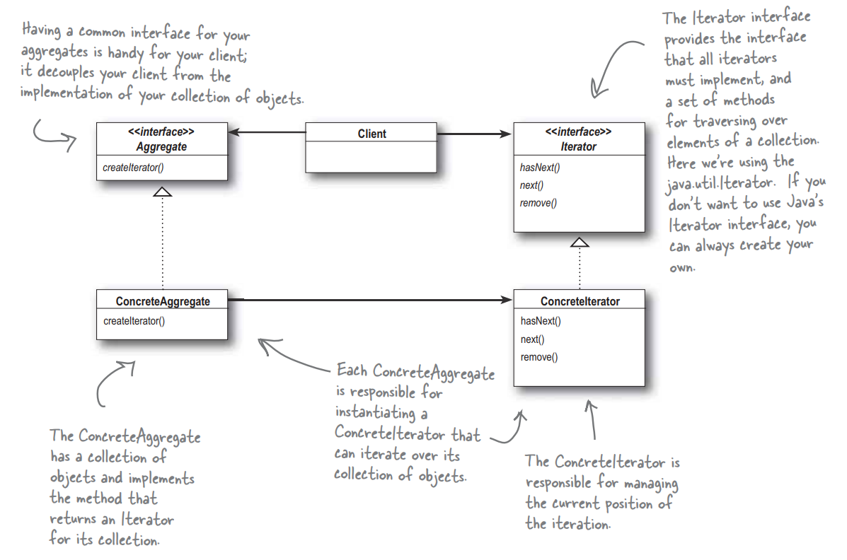
Iterator Pattern

Slide 28
The Principle of Single Responsibility
Why do we not let collections manage their own iteration?
Why is it bad to increase the number of methods?
This would give the collection two reasons to change if we were to evolve the class.
A class should have only one reason to change.
Protect what changes from what might not (or from other aspects that change).
Assign each responsibility to one class alone.
This is hard to ensure. Look for signals that a class is changing in multiple ways as the system grows.
Notes:
(1) in addition to collection-related operations like adding and removing? That would expand the number of methods in the collection. Why is that bad? Well, (3). So, again, change is at the center of yet another design principle. (4-5). Having two ways to change means a higher probability of change in the future, and when it does, it willl affect two aspects of our design. (6)

Slide 29
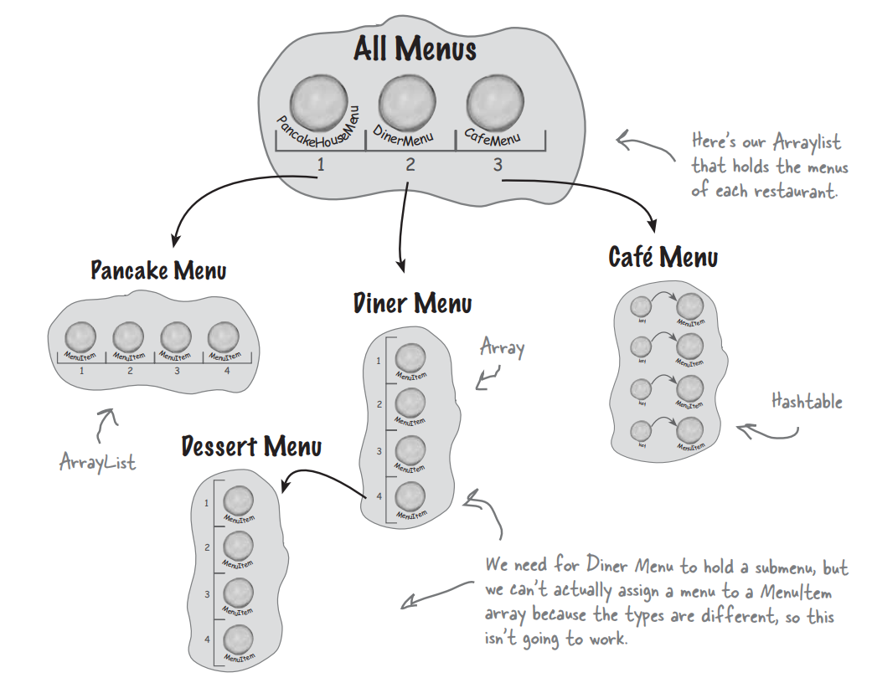
Adding a Dessert Submenu
Notes:
Ok, now we want to make a change to this system. We want to add a dessert submenu to our system - as a menu available under the diner menu. Now we have to support not only multiple menus, but menus within menus. What would be nice would be to define a hierarchy, and place the dessert menu as an item within the diner menu. However, this won’t work as implemented.

Slide 30
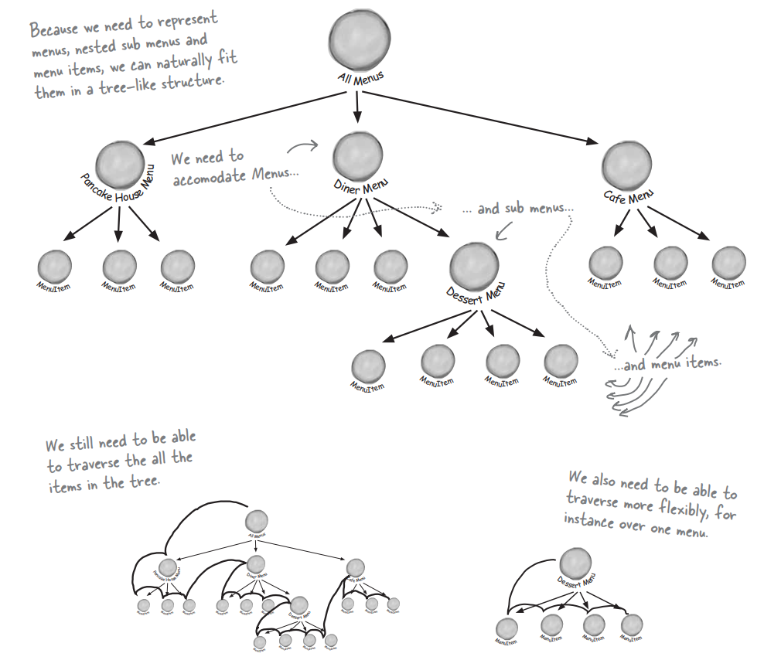
What Do We Need?
Notes:
Now, we’re going to make an executive decision and override the diner’s original implementation into something that is general enough to work over all menus and submenus. What do we need out of this design?
We need a tree-shaped structure that will handle menus, submenus, and menu items.
We need to make sure we maintain an easy way to traverse the items in each menu.Similar to using Iterators
We need a flexible way to traverse items. We might want to iterate only over the dessert menu or over the entire diner menu (including the dessert submenu).

Slide 31
The Composite Pattern
The Composite Pattern allows you to compose objects into tree structures to represent hierarchies.
Composite lets clients treat individual objects and compositions of objects uniformly.
Elements with child elements are called nodes.
Elements without children are called leaves.
Menus are nodes, MenuItems are leaves.
Menus are compositions of other Menus and MenuItems.
The Composite Pattern allows us to write code that can apply the same operation (i.e., printing) over the entire Menu structure.
Notes:
We can introduce another pattern to solve this problem. (1) - a structural pattern. (2-4). Let’s think about this in terms of our menus. This pattern gives us a way to create a tree structure that can handle a nested group of menus and menu items in the same structure. This creates a hierarchy - a tree of objects made up of parts (menus and menu items) that can be treated as a whole - a big uber menu. We can use this pattern to treat individual objects and compositions of objects uniformly - this means we have a tree structure where the menus are nodes and menuitems are leaves, where any menu is a compositino because it can contain menus and menu items. (last point)

Slide 32
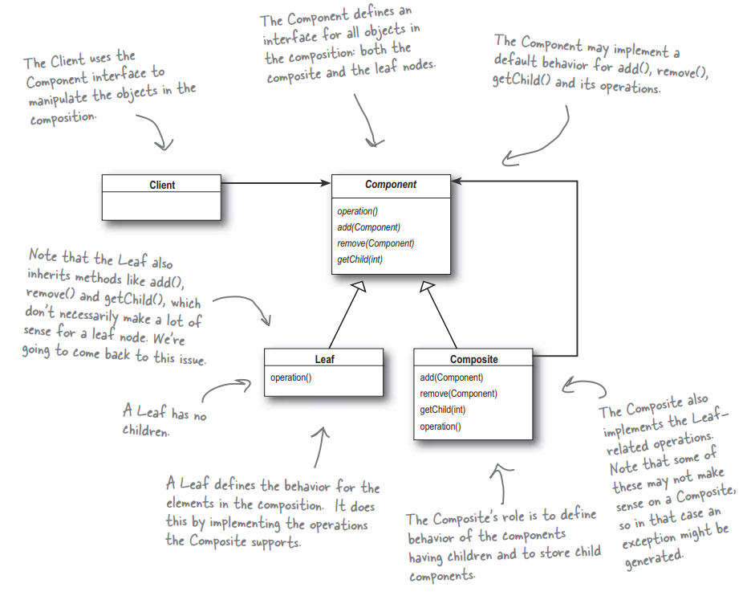
The Composite Pattern

Slide 33
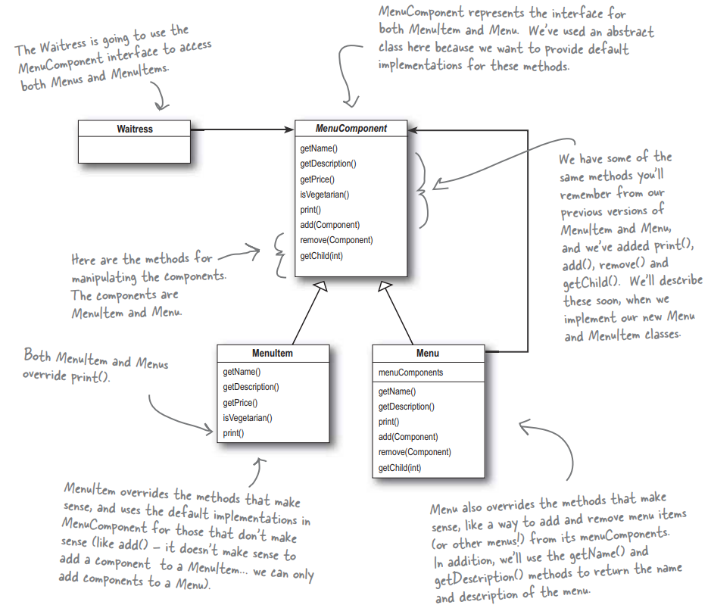
Designing Menus with Composite
Notes:
How do we apply the composite pattern to our menus? To start with, we need to create a component interface - this acts as the common interface for both menus and menu items and lets us treat them uniformly. We can call the same method on menus or menu items.
(MenuComponent is an abstract class, with a default implementation for certain methods)

Slide 34
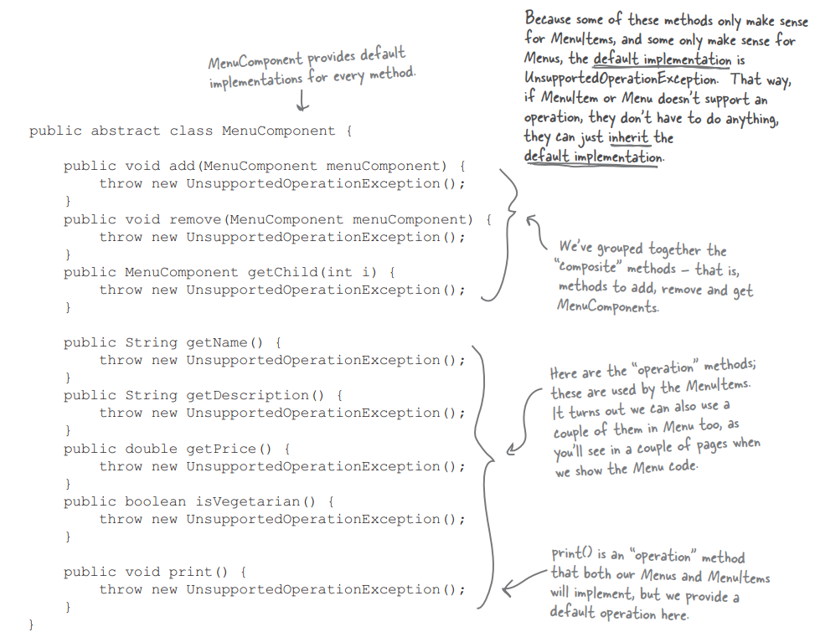
Implementing MenuComponent
Notes:
Let’s take a deeper look at this menu component abstract class. This provides a basic template for the leaf nodes amd the composite nodes. This provides a default implementation of methods, so that MenuItem and Menu can only implement the operations they need.

Slide 35
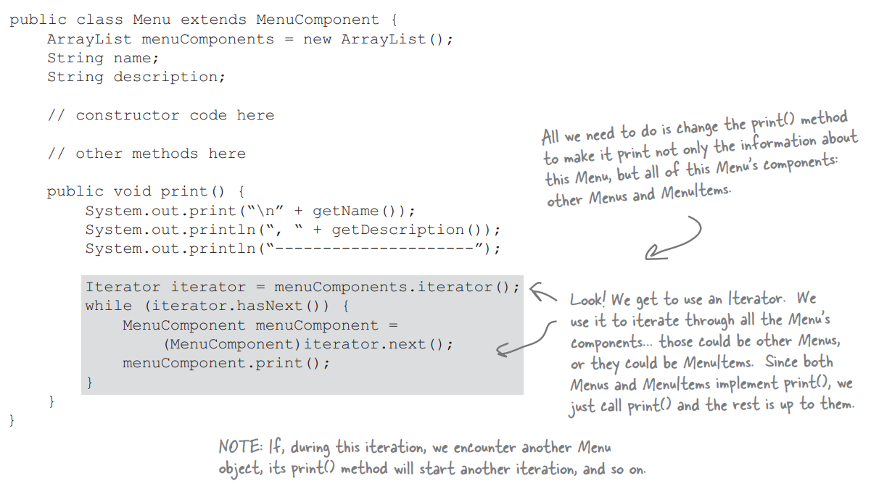
Implementing Menu Printing
Notes:
Now, we want to be able to print the contents of a menu in a flexible manner. We can do this by using an Iterator, and recusively calling the print method of each component of the menu - whether it is a submenu or a menu item.

Slide 36
A Design Trade-Off
The Composite Pattern violates the Single Responsibility principle.
Composite Pattern manages a hierarchy and performs operations on items in the hierarchy.
Composite Pattern trades safety for transparency.
A client can treat composite and leaf nodes uniformly. The type of node (composite or leaf) is transparent to the client.
We lose safety because the client might try to apply inappropriate operations to an element.
Notes:
(1-3). What is transparency? By allowing the component interace to contain child management operations and leaf operations, a client can (4). Since we have both types of operations in the Component class, we lose a bit of safety because(5), like adding a menu to a menu item. This is a design decision - we could go in the other direction and separate responsibilities into interfaces. This would make the design safe, but we’d lose transparency and would have to use conditional operators in our code to see what kind of element we are working with. This is a classic case of trade-off. We are guided by these design principles, but we need to observe what effect they have on our design. In some cases, we need to violate one principle to maintain others or ensure a well-designed program.

Slide 37
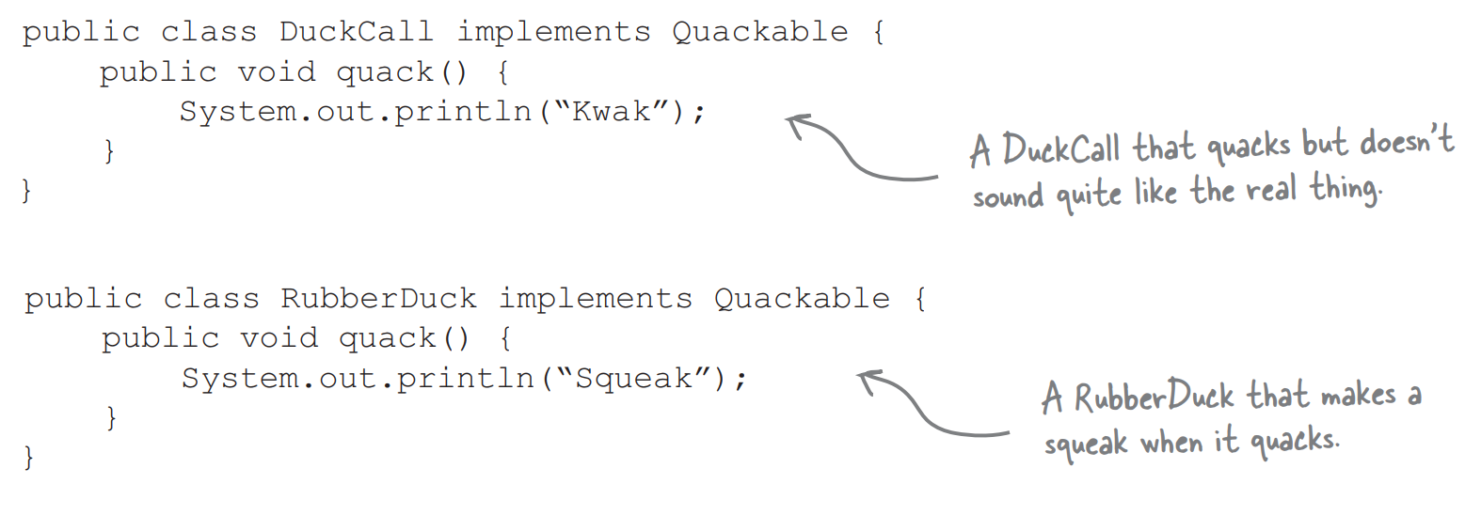
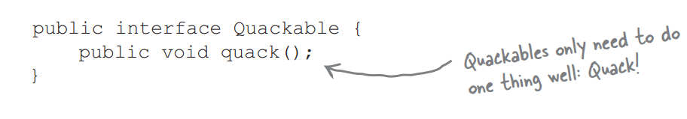
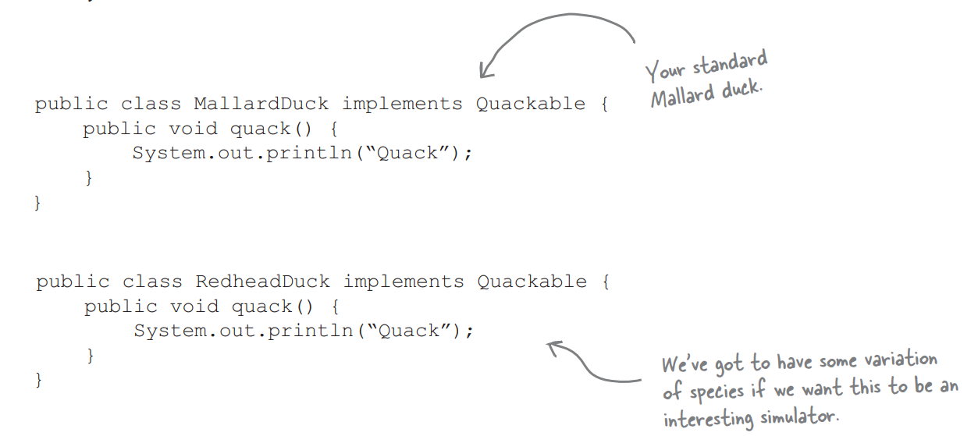
Bringing Back the Ducks
First, we need a Quackable interface.
Now, some Ducks that implement Quackable
Notes:
Remember the ducks from our first design pattern class. Let’s bring them back together to show how patterns can coexist with each other. So, let’s rebuild our duck simulator from scratch and use a bunch of patterns to give it interesting capabilities (1) Ducks will implement this to let us know that can quack - the mallard, redhead, duck call, we might even let in the rubber duck. (2). Some concrete ducks to work with. And duck-like objects

Slide 38
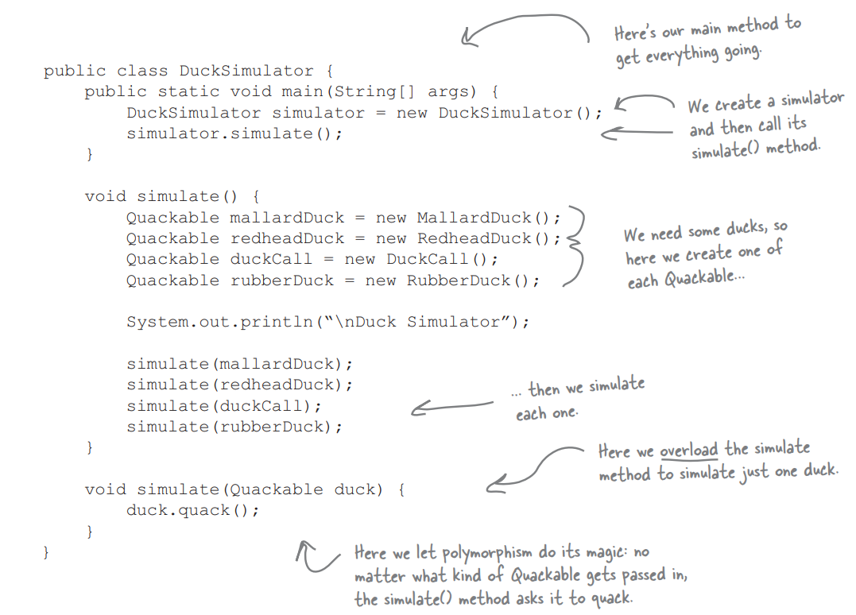
… And Our Duck Simulator
Notes:
And let’s cook up a basic simulator that creates ducks and make sure they can quack

Slide 39
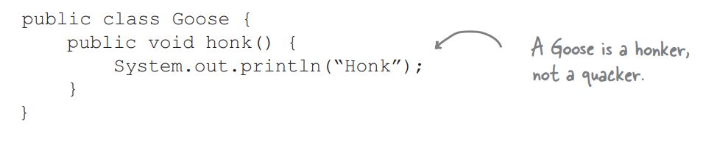
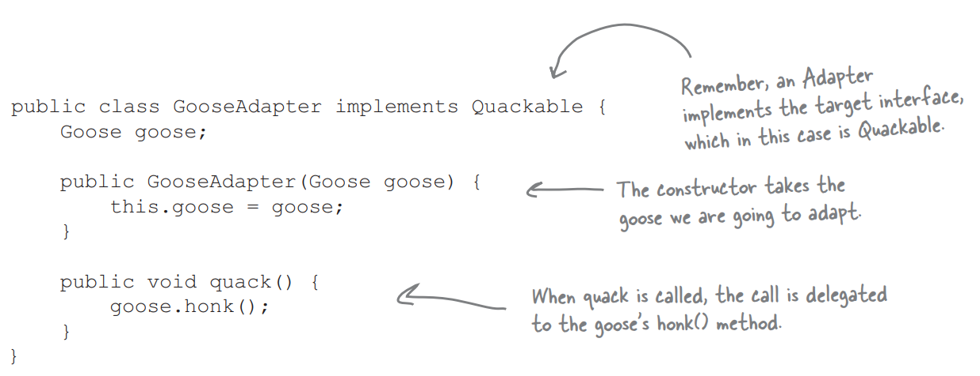
Challenge 1: Geese!
Geese are not Ducks, but we can make them Ducks using the Adapter Pattern
Notes:
Let’s get a Goose in here. And.. well.. Geese aren’t Ducks. So, how do we make this work? Well, we need an Adaptor. Let’s apply the Adapter pattern.

Slide 40
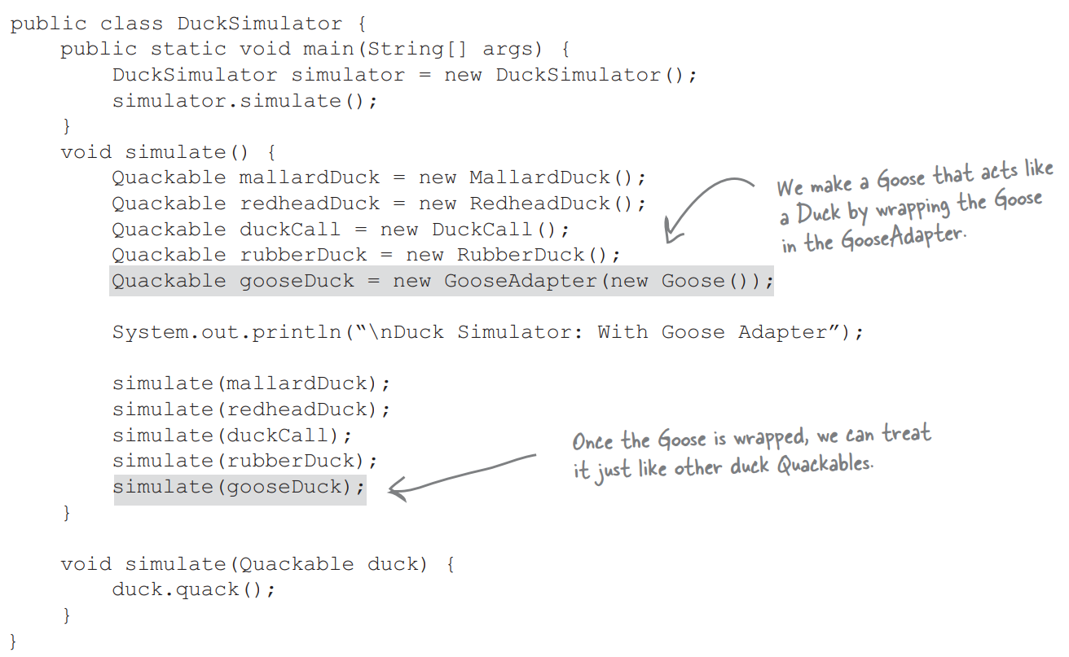
Integrating Geese into the Simulator
Notes:
Now geese can play too, all we need to do is create a Goose, wrap it in an adapter, and we are good to go.

Slide 41
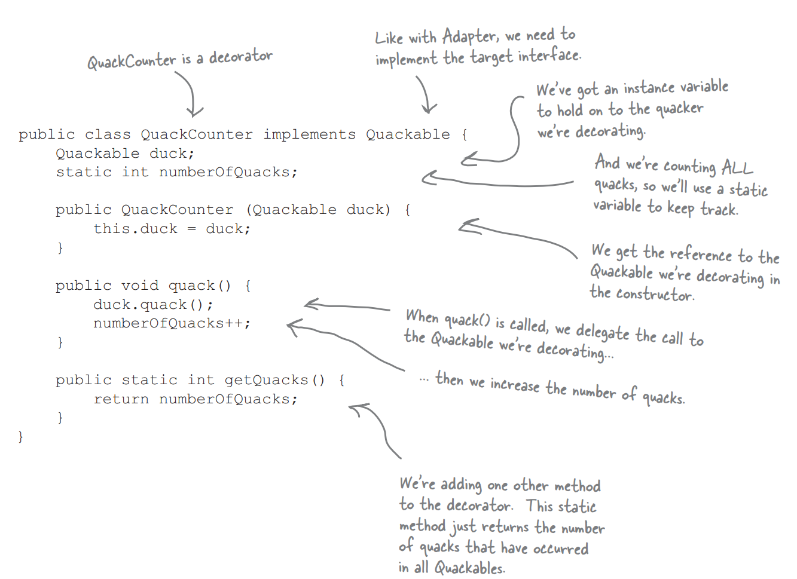
Challenge 2: Counting Quacks
A biologist wants us to count the quacks, for some reason…
We can create a Decorator that gives Ducks a new behavior (counting) by wrapping a Duck with a decorator object.
We do not need to change Duck behavior at all.

Slide 42
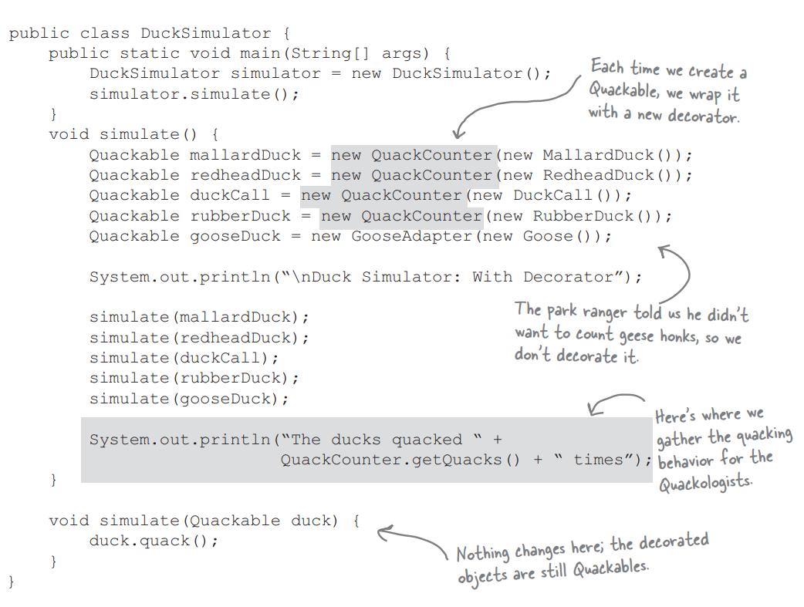
Integrating Counting into the Sim
Notes:
We just need to update the simulator to create decorated ducks. We wrap each Quackable object in a QuackCounter Decorator. If we don’t, we’ll have ducks that do not count their quacks.

Slide 43
Challenge 3: Easy Duck Creation
We might find that too many Ducks are being created without the decorator.
You have to remember to decorate objects to get decorated behavior.
We should take Duck creation and localize it to one code location.
Take Duck creation and decorating and encapsulate it in one spot.
We can create a Duck Factory.

Slide 44
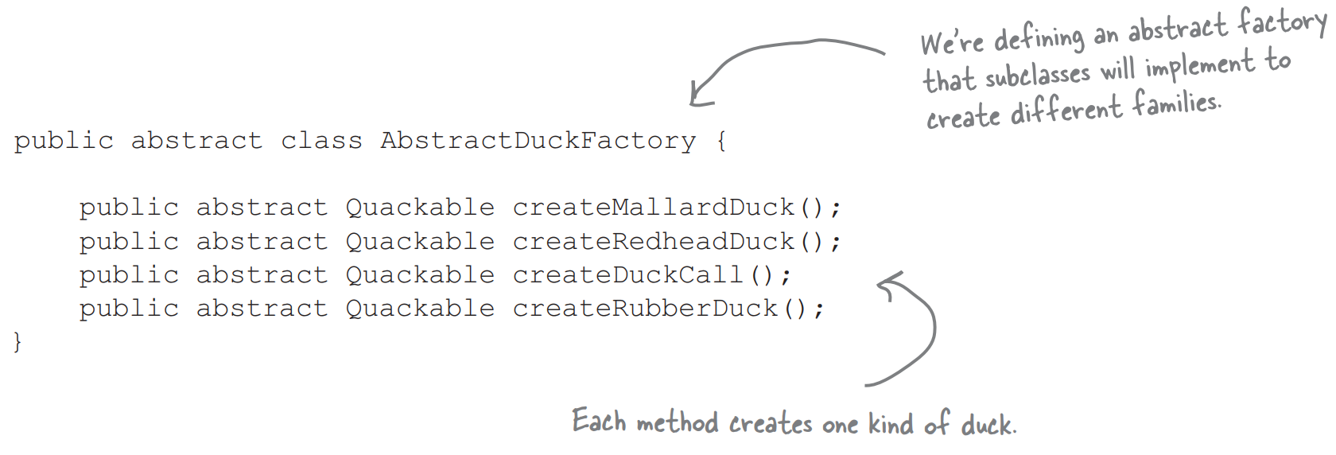
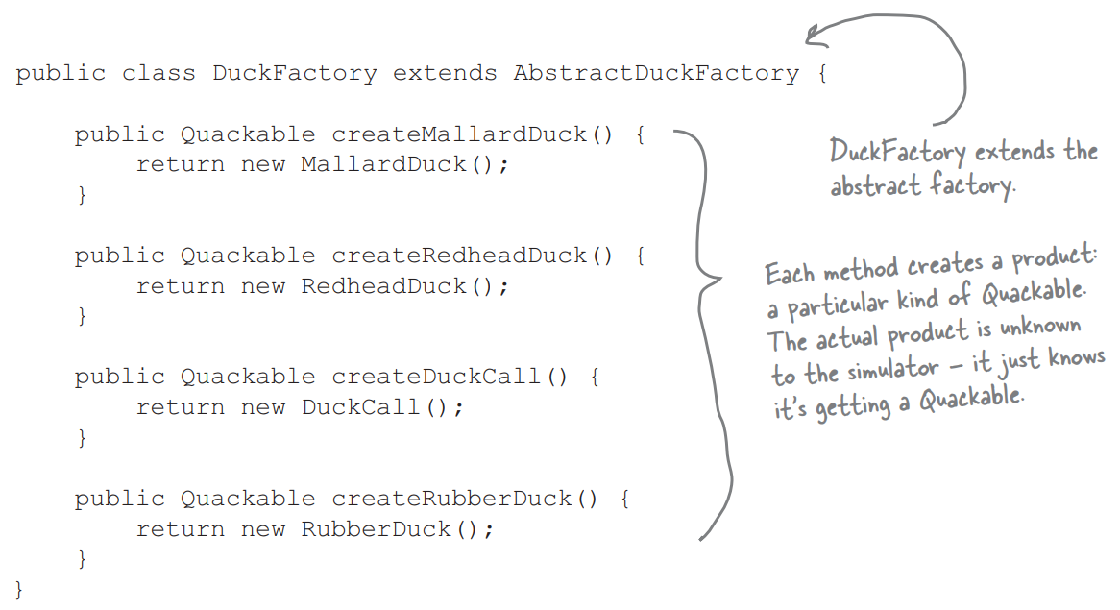
Duck Factory
Notes:
We start by defining our abstract duck factory, defining the types of ducks we will create. Then, we extend that into a concrete factor that creates plain, undecorated ducks as a reminder of how the factory works

Slide 45
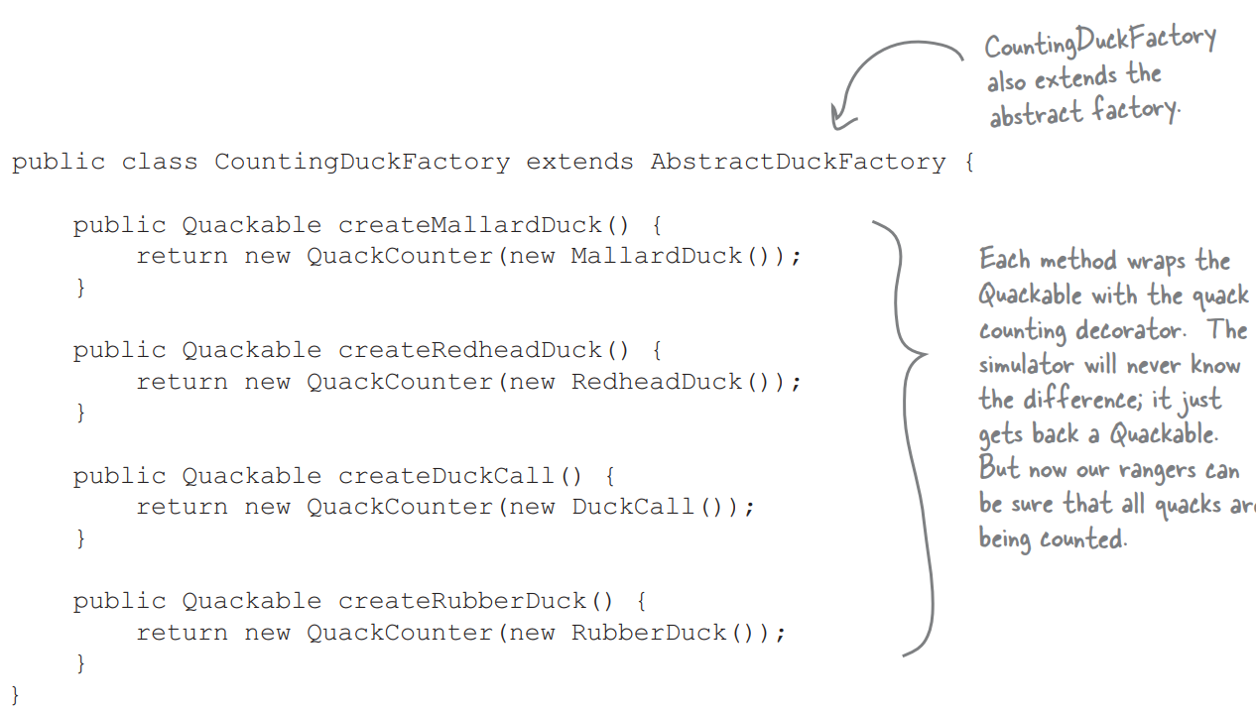
Decorated Duck Factory
Notes:
Now, the one we really want, the CountingDuckFactory

Slide 46
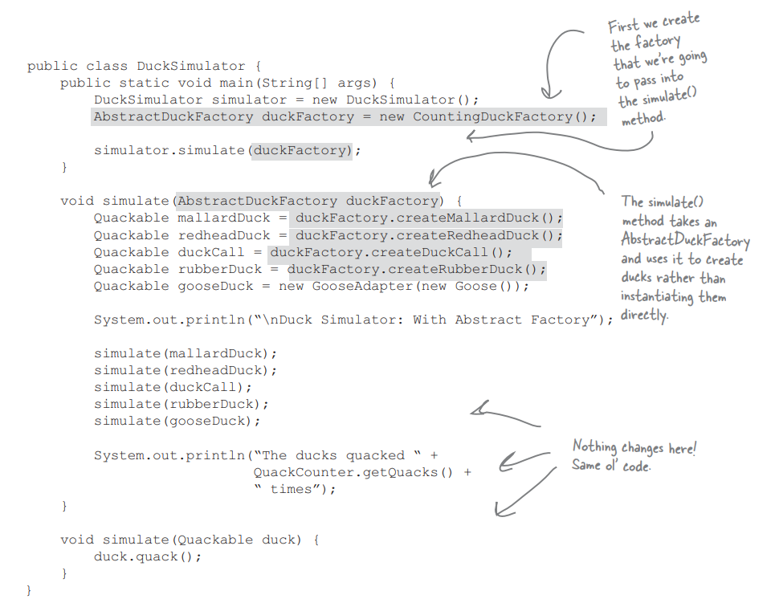
Integrating the Factory
Notes:
We create a Polymorphic method that takes in a factory and uses it to create objects. By passing in idfferent factories, we get to use different product families in the method. We alter the simulate method to take a factory and use it to create ducks.

Slide 47
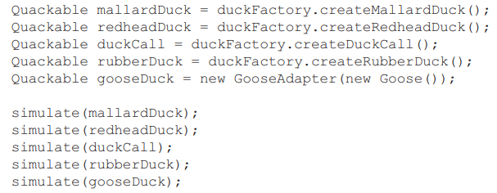
Challenge 4: Managing a Flock
This is not very manageable.
Why are we managing ducks individually?
We need a way to talk about collections of Ducks (flocks?) or subcollections of Ducks (to please our biologist).
The Composite pattern allows us to treat a group as we would an individual.

Slide 48
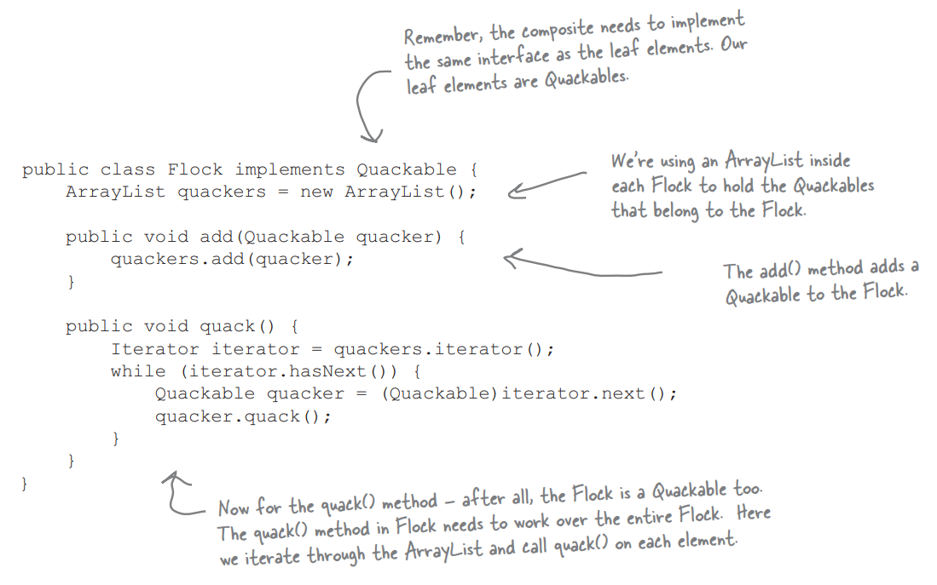
Creating a Flock
(Also - spot the Iterator)
Notes:
One note here - we did not add this behavior into the Quackable interface - only Flocks can use the add method, not Ducks. This is the opposite of the trade-off we made in the Menu example. We trade transparency for safety. Flocks and Ducks are not treated as exactly the same - we can add to a flock but not a duck - but we gain safety by not letting other parts of the code try to add to a duck.

Slide 49
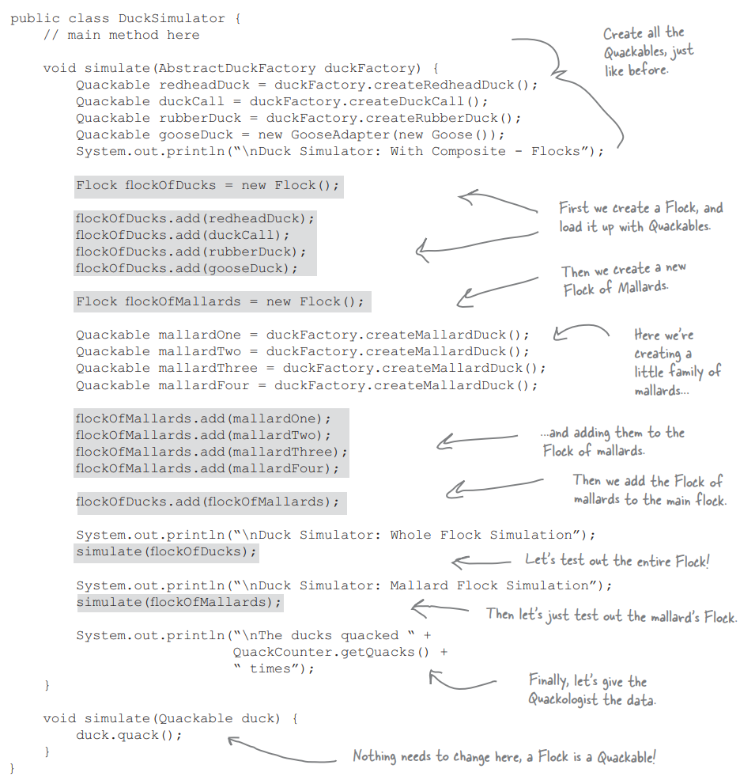
Integrating the Flock
Notes:
There we go - four, no five patterns - adapter, decorator, factory, composite, adn iterator.

Slide 50
Wrapping Up
Template Method Pattern encapsulates pieces of algorithms so that subclasses can hook into a computation.
Iterator Pattern encapsulates the details of iterating through collections of items.
Composite Pattern allows transparent treatment of collections and items.

Slide 51
Next Time
From Design to Implementation
Modeling dynamic behavior of objects.
UML sequence diagrams
Implementation practices
Reading
Sommerville, chapter 5, 7
Fowler, chapter 4
Homework 3
Due April 7
Notes:
read

